Slide 1
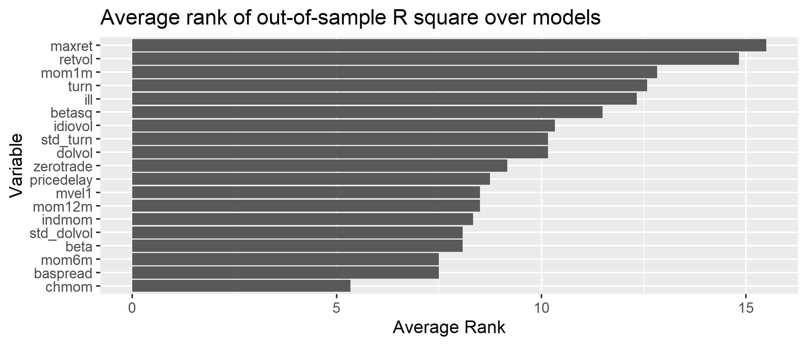
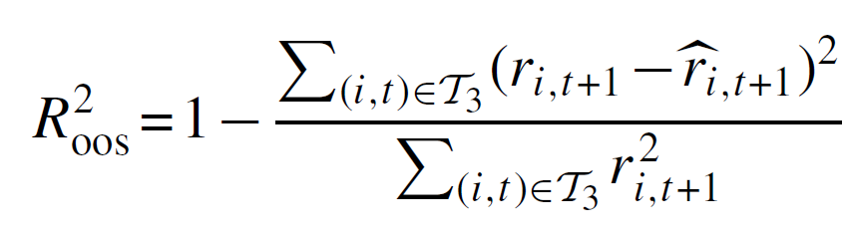
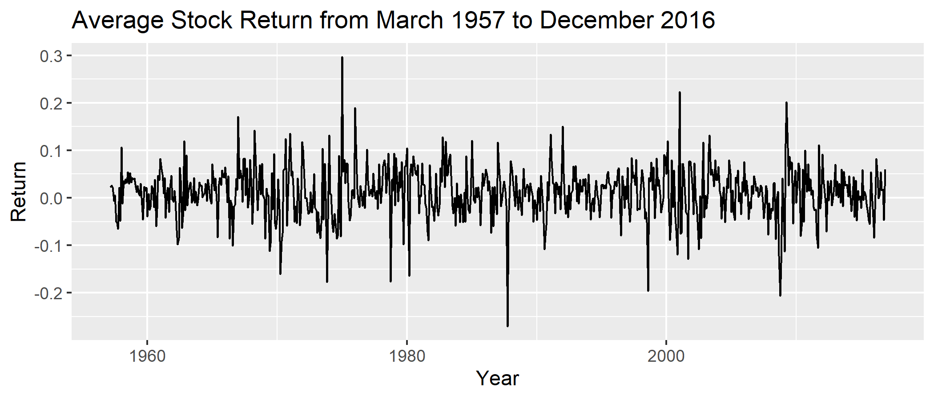
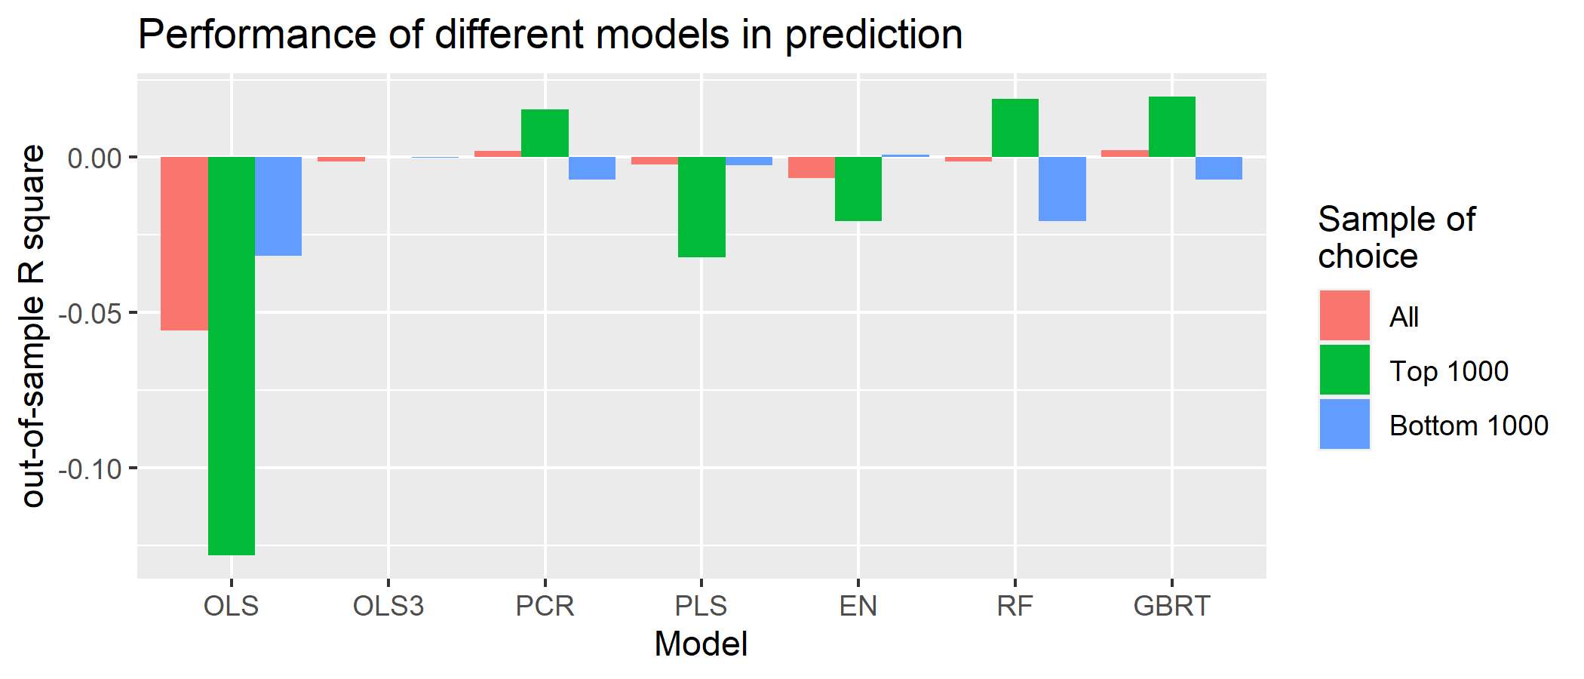


MATH 5470 Course Project: Paper Replication: Empirical Asset Pricing via Machine Learning
Chan Wing Chun wcchanau@connect.ust.hk
Department of ISOM
1. Introduction
3. Data Splitting
5. Variable Importance
In the era of Big data, there are many machine learning tools which helps us to conduct analysis. On asset pricing perspective, we aim for the best model to predict the future performance in stock returns. We are going to compare the performance of several commonly used machine learning techniques in this project.
For each model, we split our data into use first 18 years of training, next 12 years of validating, and last 30 years of testing. To assess the performance along time, we repeat the experiment by including one more year of training and shifting the validation by one year until we have used up all the data.
We calculate the variable importance $VI_{j}$, the negative of out-of-sample $R^{2}$ when the $j^{th}$ variable in the testing dataset are replaced by 0. A higher $VI_{j}$implies a higher importance of that variable in the model. We presents the average rank the $VI_{j}$ obtained in each model.
The result from the above figures shows that the maximum daily return and return volatility are the most important variables affecting the prediction performance.
2. Our Dataset
4. Predictive Performance
We have collected the monthly equity returns of around 30,000 stocks from March 1957 to December 2016. We would like to explore how different models would make use of 94 stock level predictive characteristic and 8 macroeconomic predictors to predict the future returns. Due to limitation on computation power, we selected those predictors with less than 10% of overall missing rate. We impute the missing by the median. These predictors are transformed so that they are bounded between -1 and 1.
We first evaluate the models by comparing the predictive performance using the out-of-sample $R^{2}.$
Besides the prediction performance of all stocks during the testing period, we also consider the performance with two sub-samples, including only top 1000 and bottom 1000 stocks in market value, respectively. The gradient boosted regression trees has the best out-of-sample $R^{2}$ for all stocks, and the subsample of top 1000. However, for the subsample of bottom 1000, the Elastic Net performs the best. The OLS has the worst performance in all three samples of choice.
6. Discussion and conclusion
Among all the models, GBRT took the longest time in training, followed by RF. Taking more time in training a model would give a better prediction performance. An exceptional case would be the PCR in the subsample of top 1000 stocks.
Among all models selected in this study, the two most important variables are related to the variation of returns in the last month. We believe the fluctuation of returns characterized the data.
3. Machine Learning Technique
We have considered ordinary least square (OLS), elastic net (ENet), principal components regression (PCR) and partial least squares (PLS), gradient boosted regression trees (GBRT), Random Forest (RF).
References
Shihao Gu, Bryan Kelly, Dacheng Xiu, Empirical Asset Pricing via Machine Learning, The Review of Financial Studies, Volume 33, Issue 5, May 2020, Pages 2223–2273, https://doi.org/10.1093/rfs/hhaa009

